Slide 1
LENDING CLUB CASE STUDY SUBMISSION
By
Ashwani Kumar
&
Anirudhya Bhattacharya

Slide 2
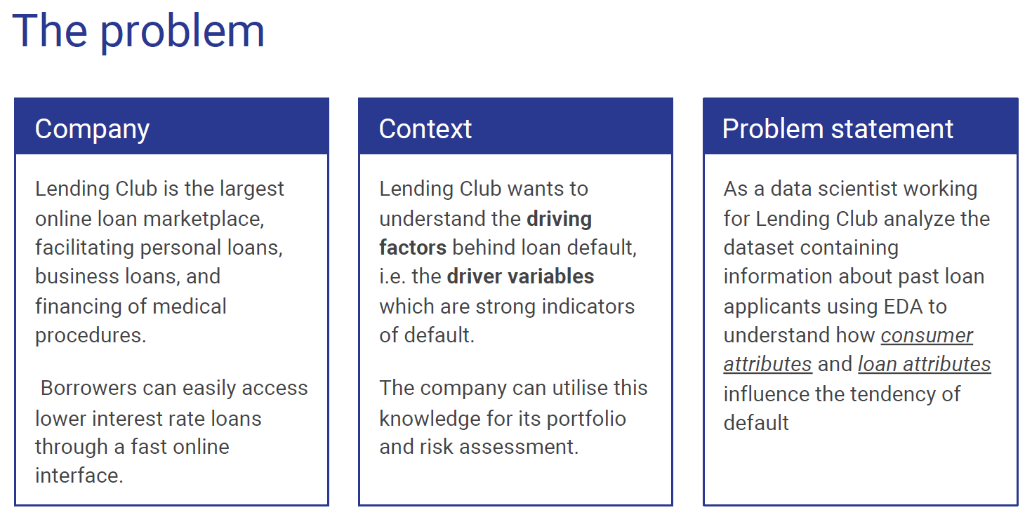

Slide 3
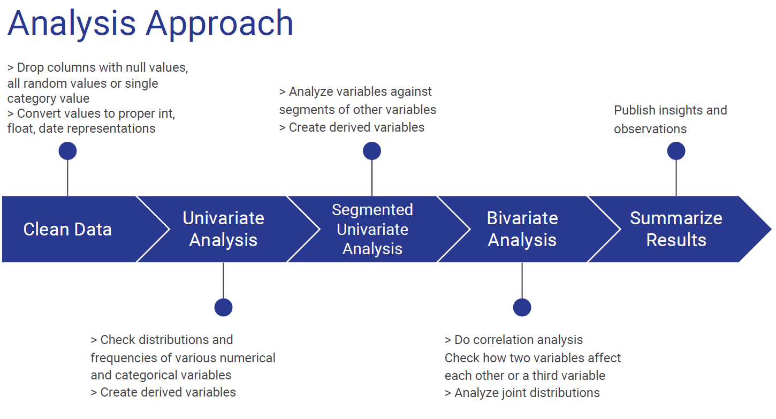

Slide 4
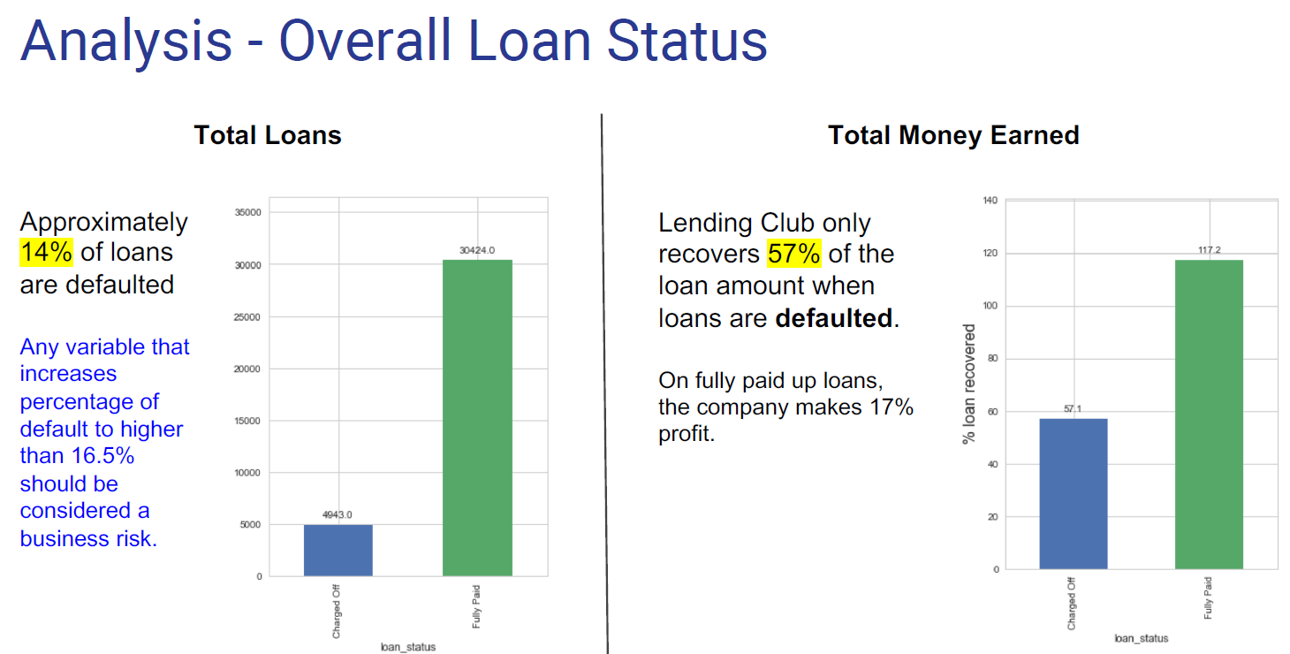

Slide 5
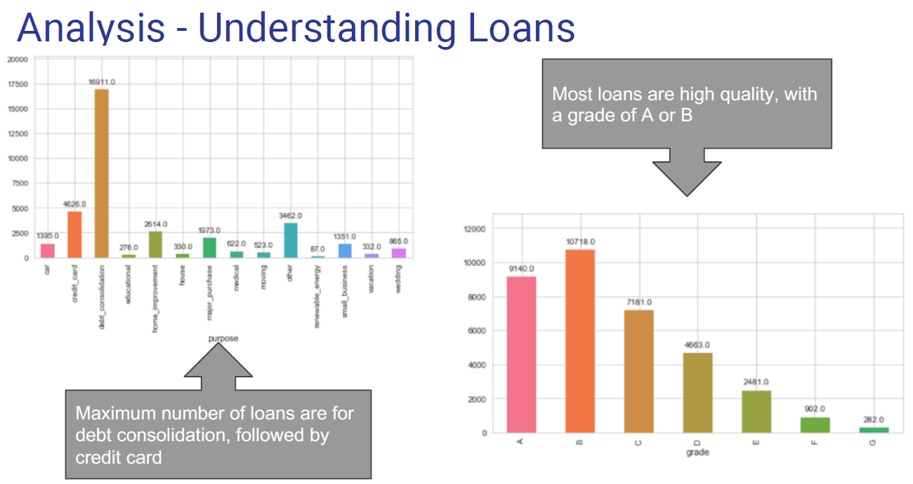

Slide 6
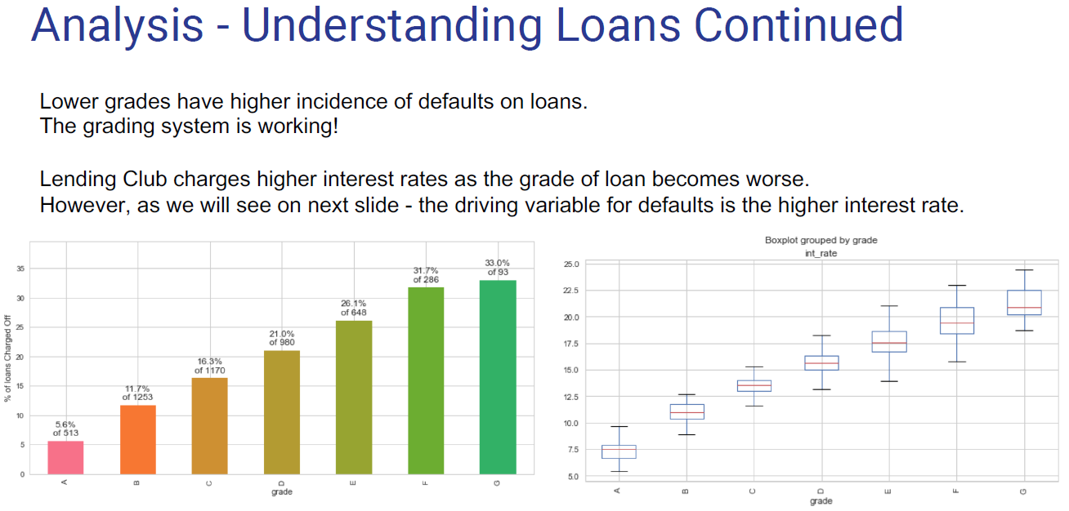

Slide 7
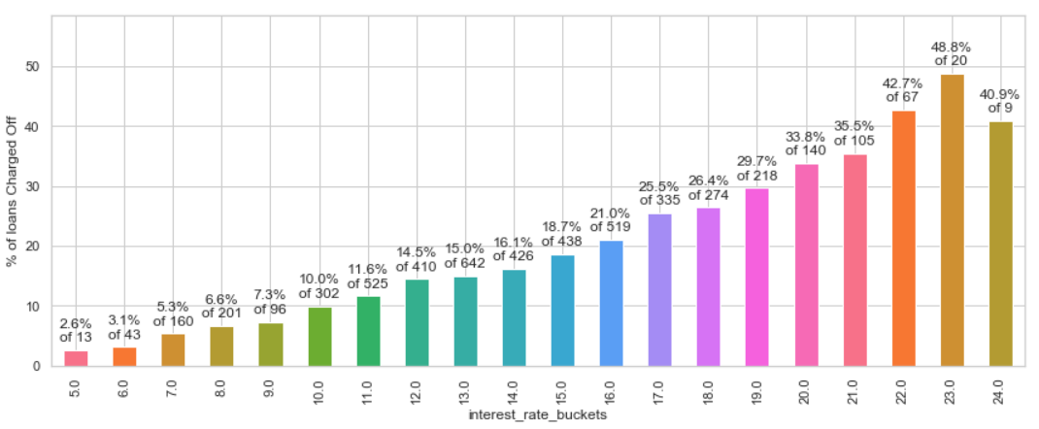
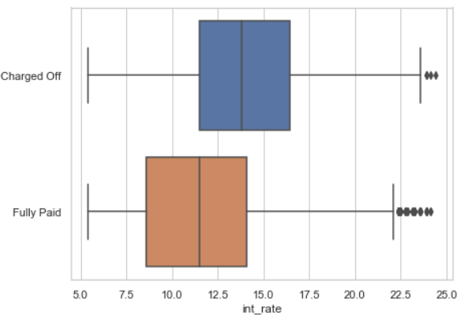
Analysis - Defaults by Interest Rate
Percentage of Defaults increases monotonically with higher interest rates. At rates of 19% and above, more than 30% of loans are Charged Off.

Slide 8
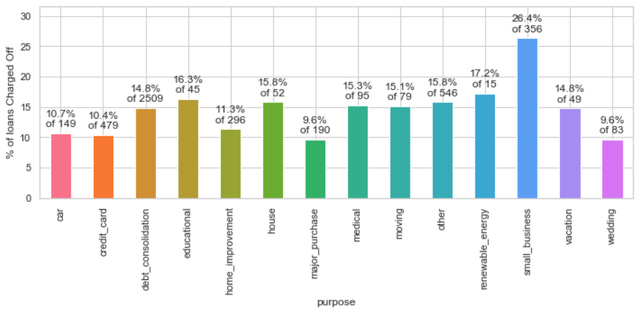
Analysis - Defaults by Loan Purpose
More than a quarter of loans taken for the purpose of running a small business are Charged Off.

Slide 9
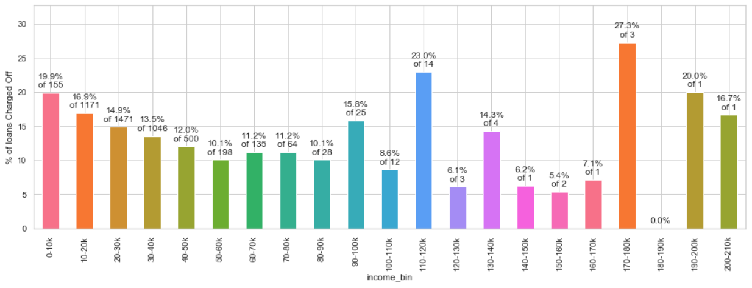
Analysis - Defaults by Borrower’s Income
Borrowers having annual income less than 20000 default on their loans at much higher rates.
Loan default decreases with higher annual income.
As we will see on next slide – the ratio of amount to income is more important.

Slide 10
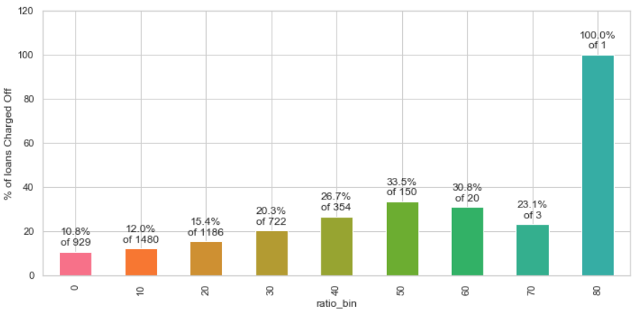
Analysis - Defaults by ratio of amount to income
As long as loan amount is less than 20% of annual income, defaults are low.
Loan amounts of 30% of annual income or higher see a high rate of default.

Slide 11
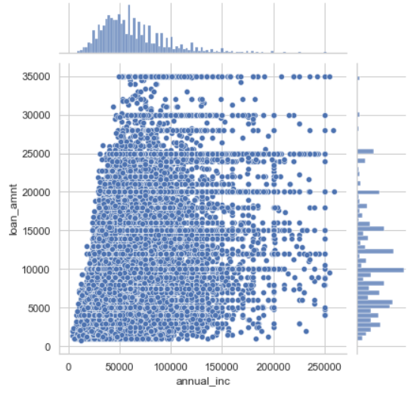
Analysis - Defaults by ratio Continued
We see here that Lending Club has extended high-value loans to people with low income.
There are many cases of people with income 50000 or less getting loans of 25000 or more.

Slide 12
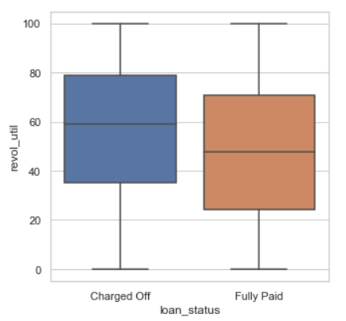
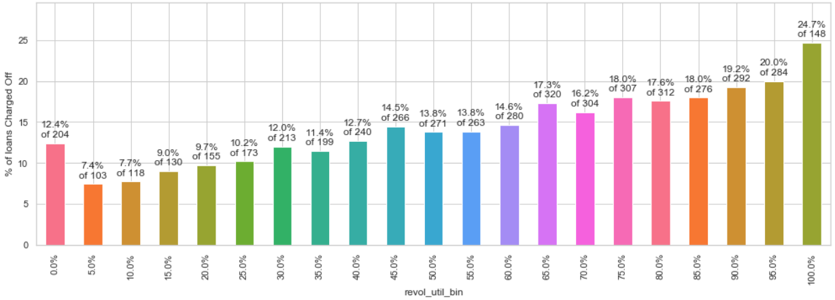
Analysis - Defaults by Revolving Line Util Rate
People with high utilization of Revolving Line of Credit at the time of taking loan default more.
Loans with utilization > 75% are risky.

Slide 13
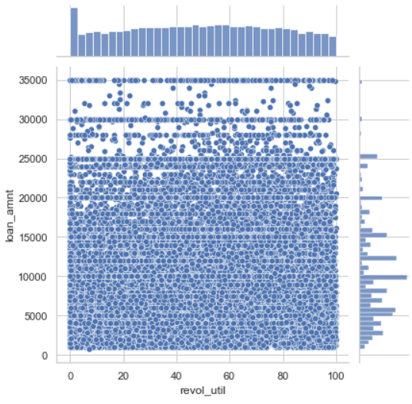
Analysis - Defaults by Revolving Line Util Rate Continued
There have been some high value loans extended to borrowers with revolving line utilization rate of higher than 75%.
This practice should be stopped.
Density of low value loans is also high. They should be approved less often.

Slide 14
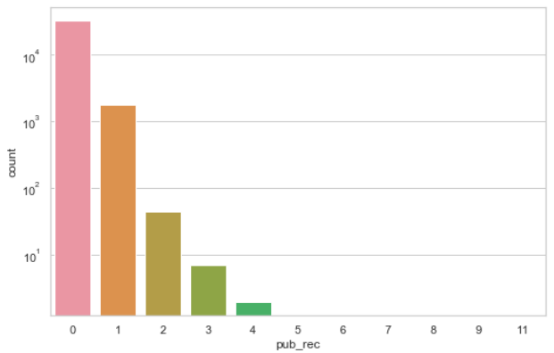
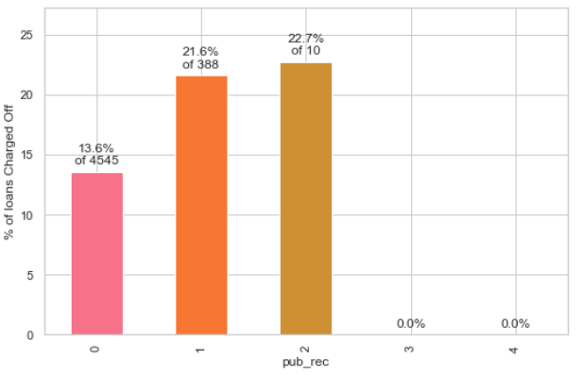
Analysis - Defaults by prior bad record
94% have no Public derogatory records.
Having even 1 derogatory record increases the chances of Charge Off significantly.
96% have no bankruptcy record.
Having even 1 bankruptcy record increases the chances of Charge Off significantly.
Public Derogatory Record and Public Bankruptcy records have 83% correlation. We can use any one.

Slide 15
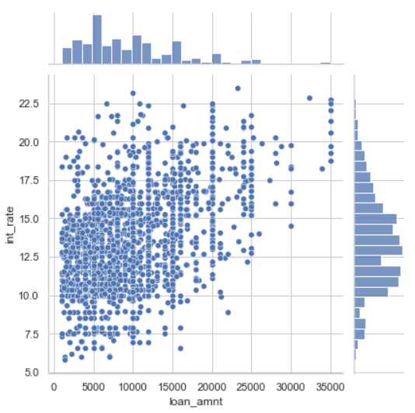
Analysis by prior bad record - Continued
High value loans, as well as low interest loans have been extended to those with prior public derogatory records.
This practice can be stopped to improve business metrics.

Slide 16
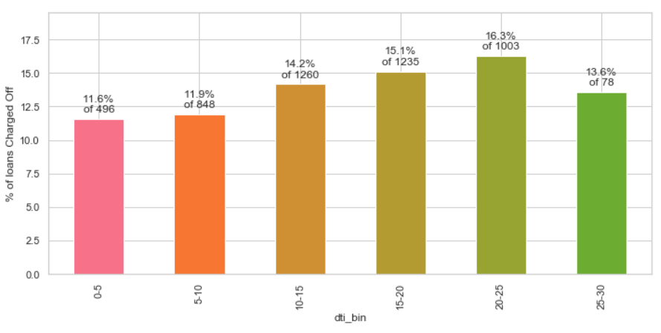
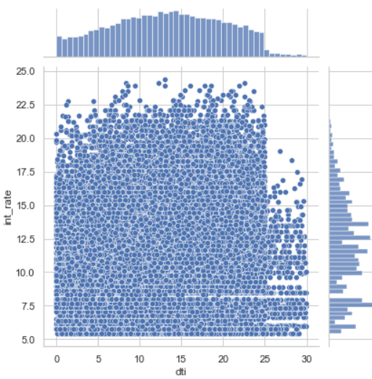
Analysis – Defaults by Debt to Income Ratio
Percentage of default rises with dti ratio.
As the dti ratio rises above 20, the loans become risky.
Higher interest rates should be charged for higher DTI, but we see spread across all values

Slide 17
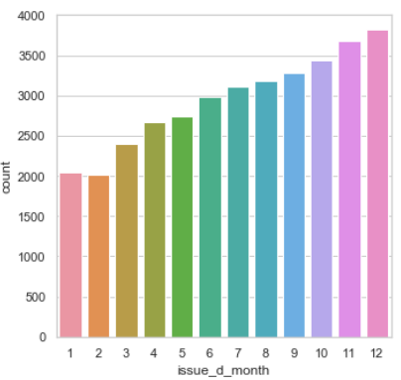
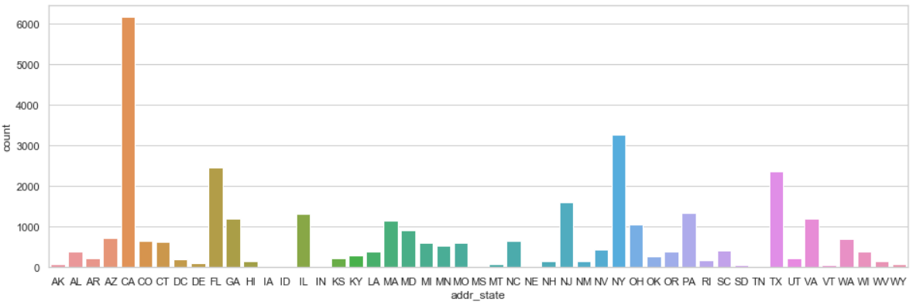
Some Interesting Observations
Loan numbers increase as months
get closer to year-end.
Maximum loans are in populous states, California, New York, Florida and Texas

Slide 18
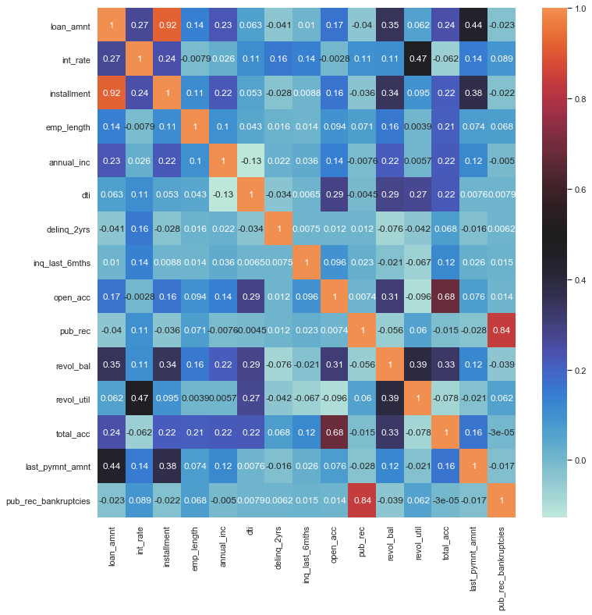
Correlation and Observation
Observation:
Loan_amount is correlated to last_payment_amount with r factor.44, as expected
int_rate is correlated to revol_util with r factor of .47 - This is good, as company is charging higher interest from riskier loan.
loan_amnt revol_bal are correlated with r factor .35 - This is not good as it suggests that higher loan amount is being approved to riskier borrowers.</mark>
delinq_2yrs is totally un-correlated with public record of bankruptcy. Therefore they represent distinct features with individual predictive value.

Slide 19
Conclusion:
Below are the top variables that are impacting the defaulters:
Grade, SubGrade -- As grade changes there are defaulters changing, G being the highest
Purpose of the loan -- Small business has more defaulters
Interest rate -- As interest rate increases defaulters are moe
Term -- There are more defaulters with 60 months term than 36 months
Annual income -- If the annual income is more then high possibility that he pays the loan
Debt to Income -- Percentage of default rises with dti ratio. As the dti ratio rises above 20, the loans become risky
Recommendations:
1. Stop – approving loans where amount/income is higher than 30%.
2. Reduce – number of approvals where purpose is small business.
3. Stop – approving high-value loans when revolving line utilization rate greater than 75%.
4. Stop – approving loans to people with prior bad record. Or at least stop approving high-value loans.
5. Start – charging higher interest rates for loans with dti greater than 20.

